Slide 1

The Social Prescription – From Patient Record to Community Insight
Paulo B. Pinho, MD – Clinical Informatics, Board Certified
November 6, 2025
Notes:
The Social Prescription – From Patient Record to Community Insight
This vital lecture explores the next frontier in personalized healthcare: bridging clinical data with Social Determinants of Health (SDOH) to achieve true health equity. Dr. Pinho will detail the limitations of current electronic medical records in capturing nuanced social data and illustrate how a data-driven, clinically led, and tech-enabled approach is necessary to meet evolving patient complexity. The session will emphasize the immense value of unstructured patient data—reading between the lines of the clinical notes—to identify social differences in care delivery and empower effective community intervention. Attendees will leave with a greater understanding of data standards, interoperability, and the technological solutions required to write the next generation of social prescriptions.

Slide 2
Faculty Disclosure Information
I have the following financial relationships with the manufacturer(s) of any commercial product(s) and/or provider(s) of commercial services discussed in this CME activity:
Stock/Bonds in: Lumeris Health, Cohere Health
Consultant for: Emtelligent, EMCNL
I will give a balanced presentation using the best available evidence to support my conclusions and recommendations.
I do not intend to discuss an unapproved/investigative use of commercial product/device in my presentation.
You are not permitted to create any alterations of this presentation or to use it for commercial or other purposes without the prior written permission of the Conference or the Presenter.

Slide 3
Learning Objectives
Achieving a Holistic View of Patient Information, Improving Patient Care and Driving Innovation in Healthcare Through Leveraging Clinical Data Agnostic of Source
At the conclusion of the presentation participants should be able to:
Understand how a data driven, tech-enabled and clinically led future are necessary to meet evolving population trends, medical complexity and the need for personalized care, changing care delivery models and provider workflow challenges
Appreciate the complexities of data standards, interoperability and structured clinical data and how it impacts social drivers of health and data equity
Understand the value of unstructured data to complete the stories of healthcare journeys; perhaps reading between the lines to identify social differences in care delivery

Slide 4
Changes You May Wish to Make in Practice
Achieving a Holistic View of Patient Information, Improving Patient Care and Driving Innovation in Healthcare Through Leveraging Clinical Data Agnostic of Source
Implement strategies to leverage automated tools for data management and analysis.
Incorporate a holistic, data-agnostic approach to patient information to improve clinical decision-making beyond medical factors and into sociodemographic realms.
Consider the adoption of innovative technologies to enhance diagnostic capabilities and patient care.

Slide 5
Agenda
Current Expectations of Data Exchange Data Equity – Can EHR Data Quality Identify those at Risk for Marginalization? EHR – More than Meets the Eye – Clinical Chronology and Social Factor Suspecting Do National Data Quality Standards Drive True Data Quality? How Well is Basic Demographic Data Captured? How do Social Divisions Impact Data Quality? Final Thoughts

Slide 6
Actual Patient Documentation Experience
A 58-year-old Caucasian, Non-Hispanic, Catholic male
with Past Medical History of Hypertension reported
Medications: Amlodipine 5 mg PO QD
presents to an urgent care center on a Saturday morning at 9:30 AM with Chief Complaint of a Head Laceration
History of present Illness - he sustained it during a fall at home “while gardening.” He states that he was walking in the back yard when he tripped on a brick in his pavers that was sticking up. He had no dizziness or lightheadedness, had no chest pain, shortness of breath, he denies weakness. He was able to get up under his own power and other than a bleeding head laceration, has no symptoms.
With the exception of the above – Review Of Systems was negative
BEST
Physician Internal Monologue
Physician Documentation Into EHR in SOAP format (semi-structured)
EHR codification of semi-structured data into structured fields
EHR outbounding structured data to end user
End user wanting to abstract physician inner monologue for use case
A 58-year-old male
with Past Medical History of Hypertension reported
Medications: Amlodipine
Chief Complaint of a Head Laceration
History of present Illness – Head Laceration after fall
Review Of Systems neg
WORST
Notes:
My work with the ACORD standards organization – premised on clinical data standards
Abandon using EHR because it doesn’t look like the PDF.
This doesn’t take into consideration complexities like medical synonyms and polysems as well as the fact that in some cases there is local representation of concepts

Slide 7
Data Equity – Can EHR Data Quality Identify those at Risk for Marginalization?
Paulo B. Pinho, MD, FAAP, FACP, Vice President and Medical Director*
Don Burt*
Sharon Pickett*
Owais M. Aftab, BS, 2nd Year Medical Student ¥
Jennifer C. Lee, BS, 2nd Year Medical Student ¥
Harrison L. Chiu, BA, 2nd Year Medical Student ¥
Kyle Meadors, President ǂ
* Diameter Health (Farmington, CT)
¥ Rutgers New Jersey Medical School (Newark, NJ)
ǂ Chart Lux Consulting (Nashville, TN)

Slide 8
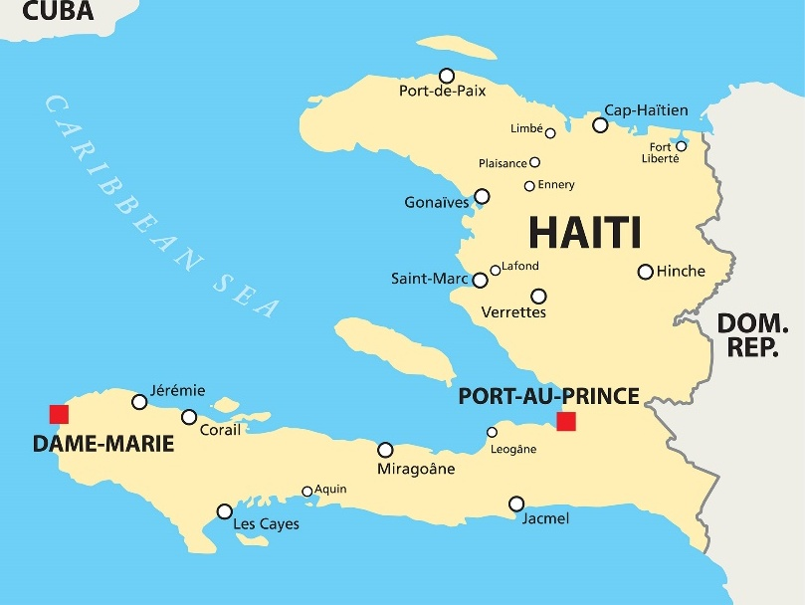
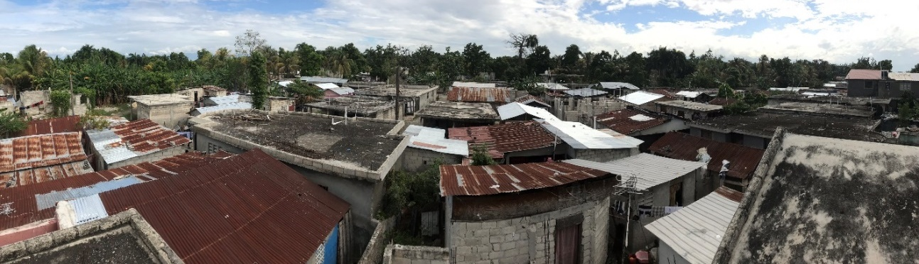
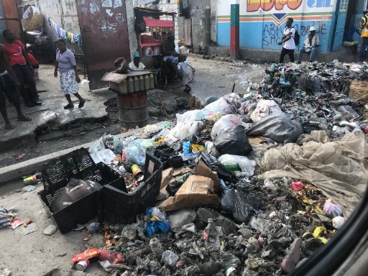
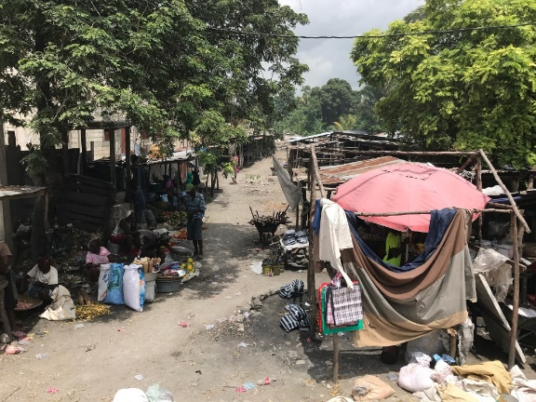
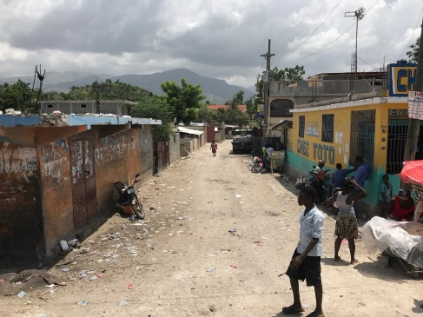
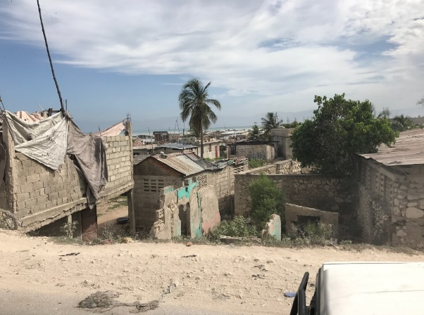
Healthcare Around the World – Haiti
https://vignette.wikia.nocookie.net/haiti/images/e/e2/Haiti_map.jpg/revision/latest?cb=20170928043819

Slide 9
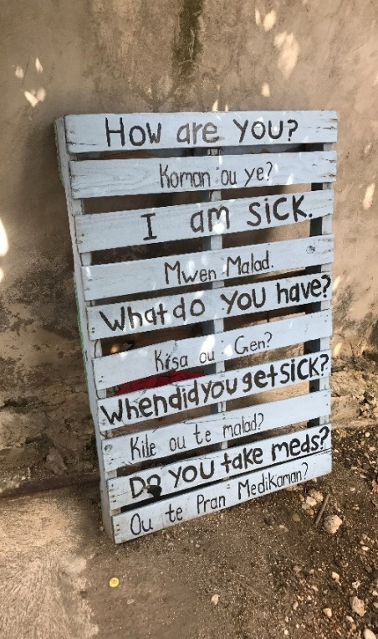
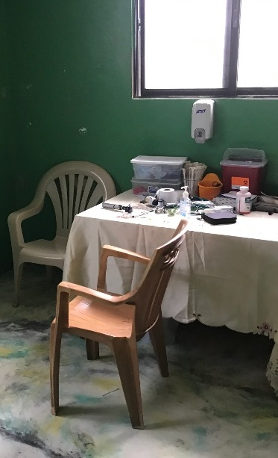
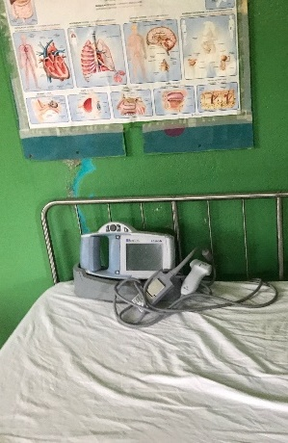
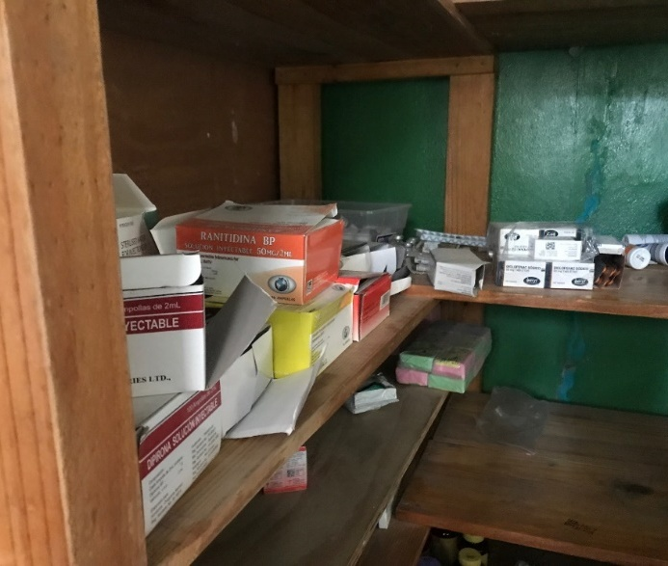
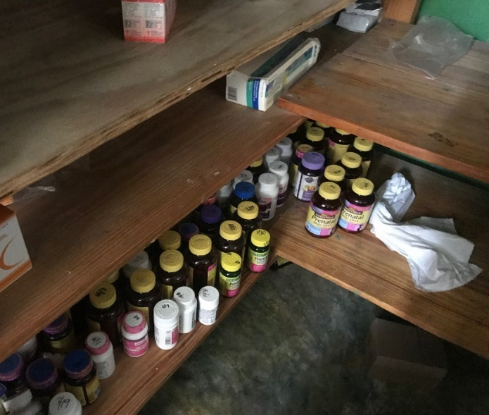
LIFE Clinic – Village Level Care in Haiti

Slide 10
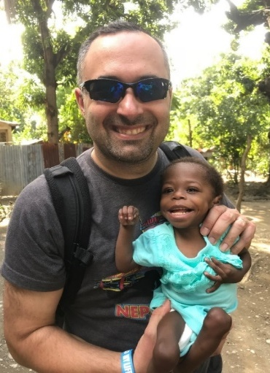
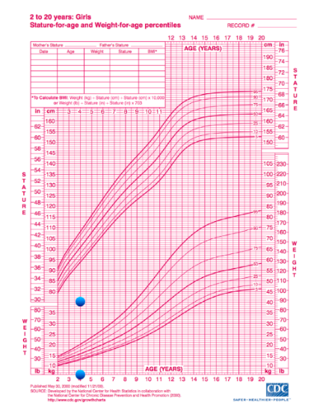
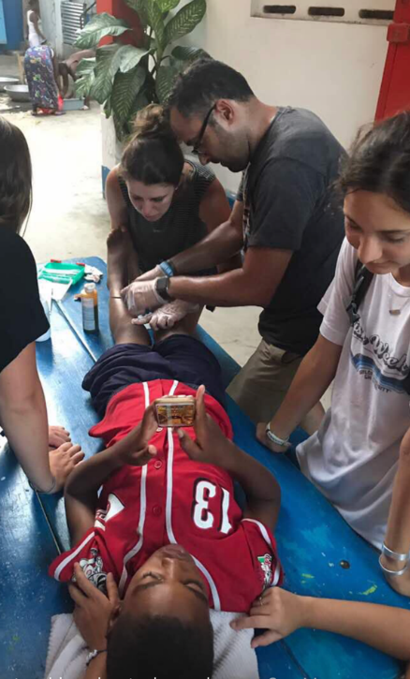
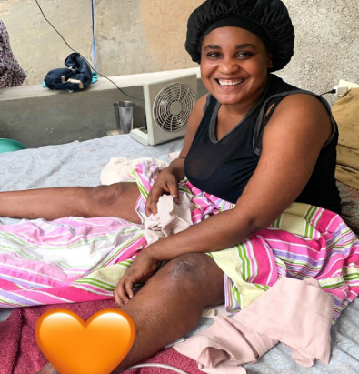
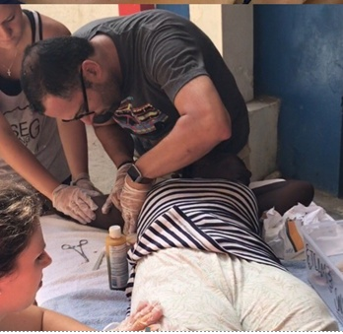
Patient Care in Leogane, Haiti
An uphill battle challenged by care access, the sick role, supply chain

Slide 11
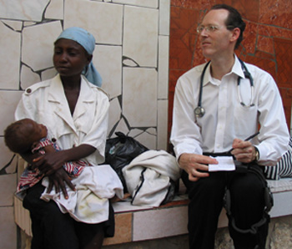
How does the United States Compare?
 | United States | Haiti
Gross National Income | $70,249 | $1,730
Poor Access to Sanitation | 0.32% | 25%
Poor Access to Clean Water | 0.6% | 50%
Food Insecurity | 12.5% | 30%
Life Expectancy | 76.1 | 63
“In an age of explosive development in the realm of medical technology, it is unnerving to find that the discoveries of Salk, Sabin, and even Pasteur remain irrelevant to much of humanity”
Paul Farmer, MD, PhD, Medical Anthropologist and Physician

Slide 12
How does the United States Compare?
 | United States | Haiti
Gross National Income | $70,249 | $1,730
Poor Access to Sanitation | 0.32% | 25%
Poor Access to Clean Water | 0.6% | 50%
Food Insecurity | 12.5% | 30%
Life Expectancy | 76.1 | 63
Annual per capita spend on healthcare ($3.82 trillion) | $12,600 | $83
Annual per capita spend on waste due to administrative, failure of care delivery, over treatment, poor care coordination ($760-$935 billion) | $3,000 | —

Slide 13
Data by Group is Available for Review and Part of Manuscript Submission
“It is very expensive to give bad medical care to poor people in a rich country.”
Paul Farmer, MD, PhD, Medical Anthropologist and Physician

Slide 14
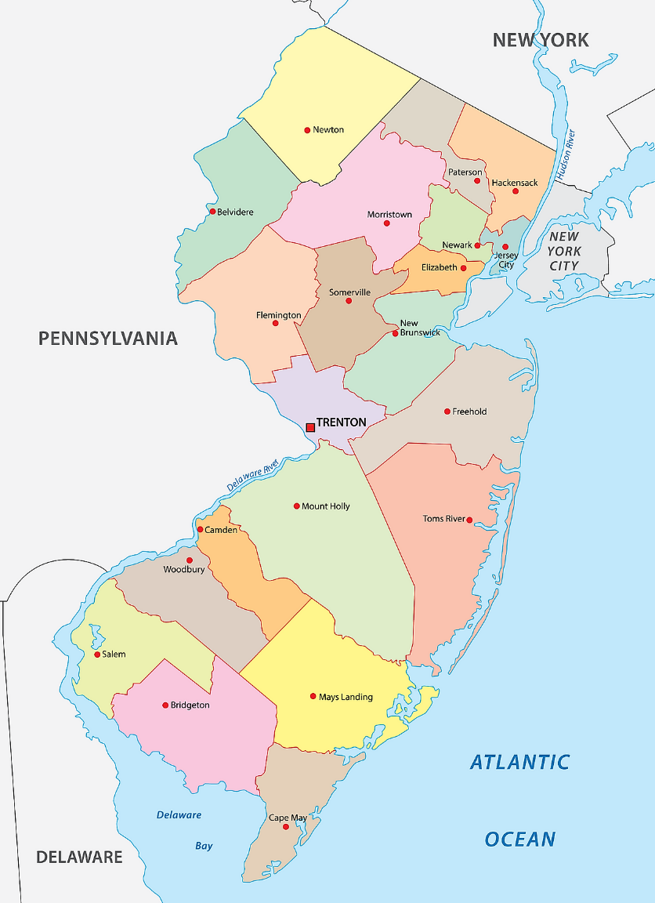
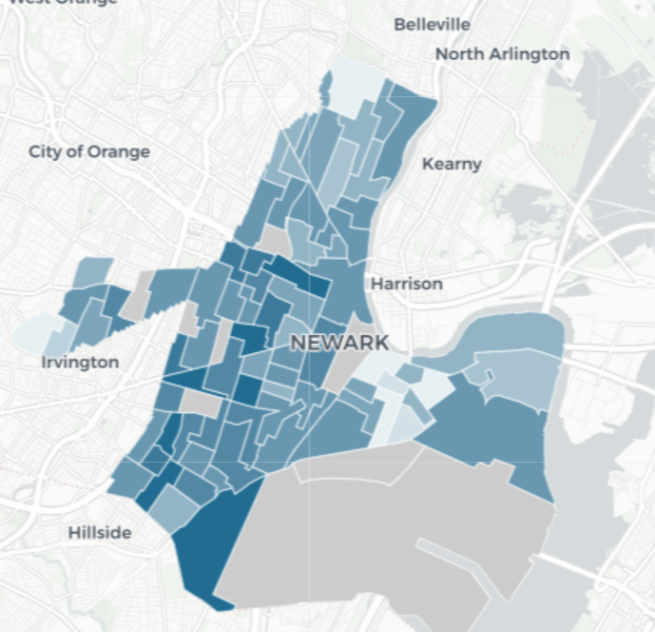
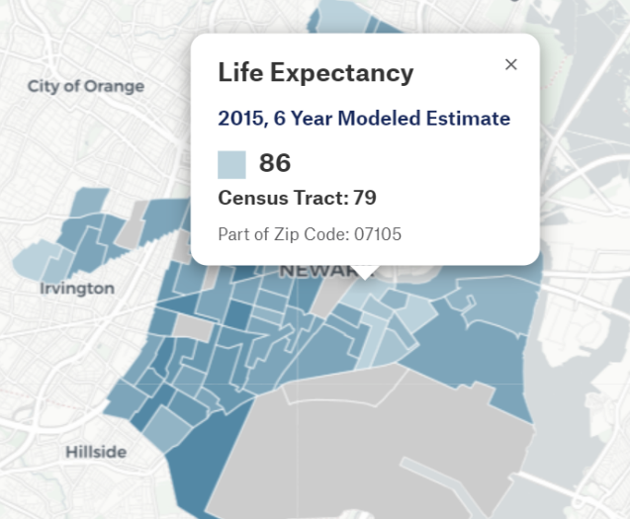
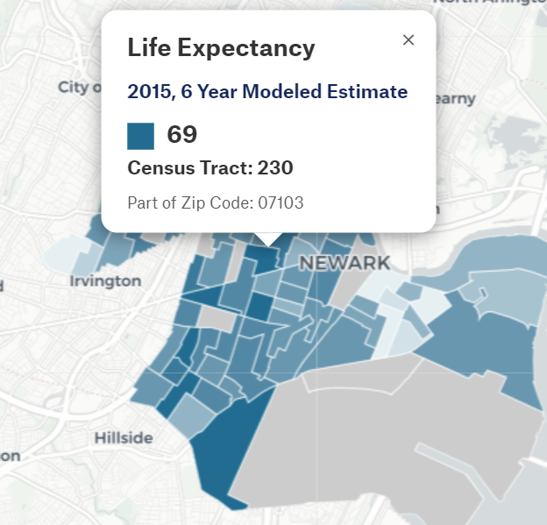
In the US, Zip Code & Street Level Divisions Have Different Care Experiences
https://www.worldatlas.com/r/w1200/upload/c0/78/96/new-jersey-counties-map.png
Notes:
1/3 of all black males in Newark never reach their 30th birthday
July 4, 1996

Slide 15

Social Vignette
Clara
75-year-old retired factory worker, widowed female with hypertension, hyperlipidemia and rheumatoid arthritis takes
Olmesartan HCT 20/12/5 = $256/30 days
Atorvastatin 40 mg = $6/30 days
Adalimumab 40mg/0.4ml = $6097.00/30 days
Total monthly cost of meds - $6359/30 days
Children live out of state
Medicare Part B covers 80% of the medications – out of pocket $1271.80/month (simplified to exclude donut hole and part B coverage)
She has no supplemental coverage
She pays $1000 in mortgage/taxes and $200/month in food bills
Total monthly spend is $2071.80 excluding incidentals

Slide 16
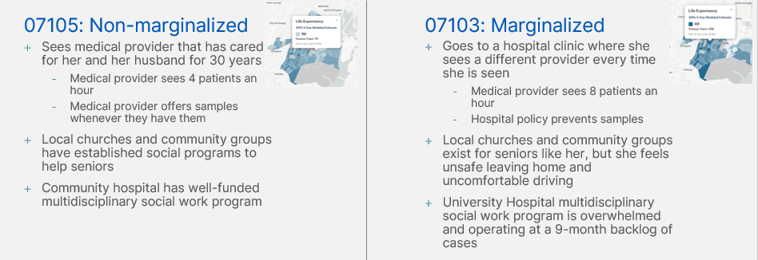
Social Drivers of Health
Does Data Equity Compromise SDOH Capture?
Income and social protection
Education
Unemployment and job insecurity
Working life conditions
Food insecurity
Housing, basic amenities and the environment
Early childhood development
Social inclusion and non-discrimination
Structural conflict
Access to affordable health services of decent quality
Notes:
Lack of consistent primary care in these communities – continuity impacts data capture
Less medical literacy and less literacy and numeracy in general; perhaps non-English speaking
Care settings which are more urgent and episodic (ER, urgent care)

Slide 17
Does the Differential Capture of SDOH Data Further Social Divide?

Slide 18
What is Data Equity?
An endless social cycle
The consideration, through an equity lens, of the ways in which data is collected, analyzed, interpreted, and distributed.
It underscores marginalized communities' unequal opportunities to provide, have their data interpreted and access data.
At times, they can be harmed from data’s misuse.
Data could potentially reinforce stereotypes, exacerbate racial bias, undermine social justice
Data Equity: What Is It, and Why Does It Matter? — Hawaii Data Collaborative

Slide 19
EHR – More than Meets the Eye – Clinical Chronology and Social Factor Suspecting

Slide 20
EHR Data Quality Study
Data Observations
40,242 CCDs studied
Spread across races, ethnicities, age groups, religions, genders, and languages
Represented various care settings (ER, specialty care, primary care)
Represented various zip codes (urban, suburban, rural) in various states
Notes:
Beyond SDOH, I was concerned about data capture in general with certain populations, when I looked at incidence and prevalence of feature documentation, it was more poorly documented, And so if we’re going to build ML models, LLM, etc., we need to make sure we are not overfitting models to populations with robust data collection and further marginalizing the marginalized.

Slide 21
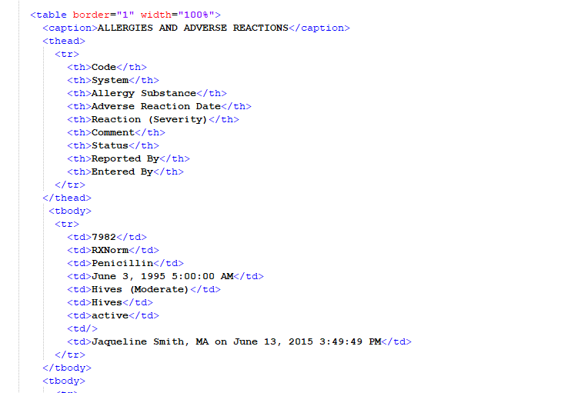
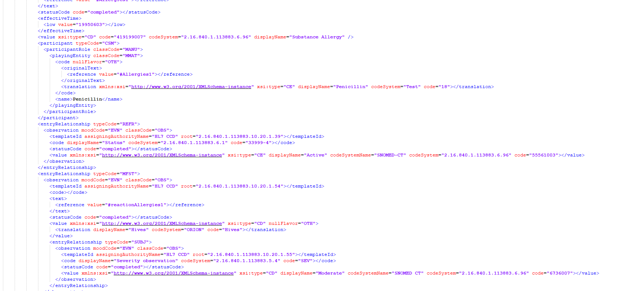
Human Readable vs. Machine Readable
Impact on Size and Count
Data Observations
Human Readable
Machine Readable
More Likely To Increase Size of Document (MB)
More Likely To Increase Count of Completeness and Syntax Rules of Document
Notes:
Completeness is about ensuring that all necessary adjectives are present and syntax is about ensuring that the content can be used to tell a story to someone else.

Slide 22
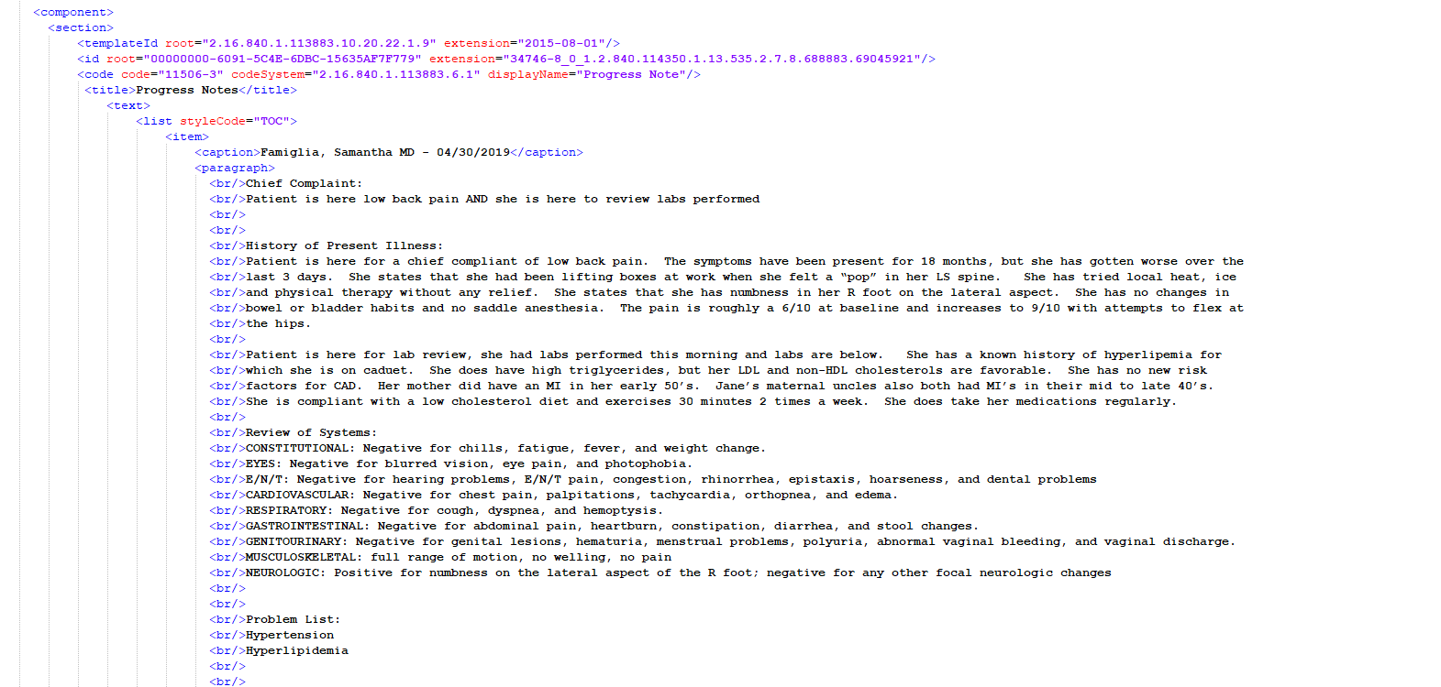
Human Readable vs. Machine Readable
Impact on Size and Count
Data Observations
Machine Readable - More Likely To Increase Count of Completeness and Syntax Rules of Document
Human Readable - More Likely To Increase Size of Document (MB)

Slide 23
Do National Data Quality Standards Drive True Data Quality?

Slide 24
Do Certification Standards Ascertain Data Quality?
Schematron vs. Completeness and Syntax
NO CORRELATION BETWEEN SCHEMATRON ADHERANCE AND DATA QUALITY
Notes:
Completeness is about ensuring that all necessary adjectives are present and syntax is about ensuring that the content can be used to tell a story to someone else.
Government set - Schema – sentence structure
Schematron – vocabulary

Slide 25
How Well is Basic Demographic Data Captured?

Slide 26

State of California Experience (128 Million Lab Reports)
Courtesy Availity Clinical Solutions
Lab Submitter Data Quality
RACE in Lab Submissions
RACE based on 2020 Census Data
Patient Count: 998,595
37.0% Hispanic or Latino
53.9% Female
Age (mean = 39.875 years)
Under 18: 18.25%
18-64: 66.83%
65 and over: 15.40%
Notes:
Other or unknown is really 7% in California – in clinical data it was 45% - over 6 times as much
Documented Caucasians comprised 60.2%, clinical data captured 70% of demographic data on Caucasians
AA – 9% - 58% captured
Asians – 24% - 37.5% captured

Slide 27
An Overview of this Analysis
Data Counts By Race
Data Observations
Notes:
In this analysis, we evaluated data quality across several different demographic variables like race, ethnicity, language, sex, age, and religion
We evaluated a sample of 40,242 continuous care documents and measured outcomes like completeness, ie if a document was filled out completely, and syntax, ie if a document was filled out correctly
We can start by discussing racial variation in data quality
Paulo

Slide 28
An Overview of this Analysis
Data Counts By Ethnicity
Data Observations

Slide 29
An Overview of this Analysis
Data Counts By Language, Administrative Gender, Age, Religion
Data Observations

Slide 30
How do Social Divisions Impact Data Quality?

Slide 31
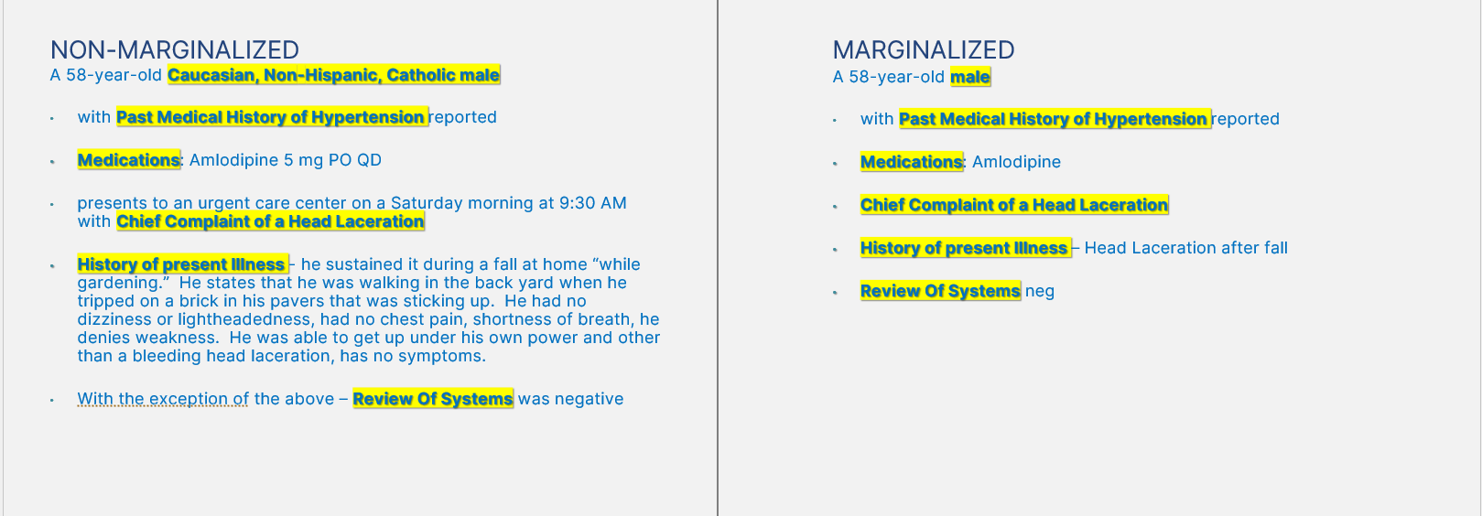
Size and Count Comparison
Of Marginalized and Non-Marginalized Data Capture
Assumption/Observation: Larger documents present more opportunities for trigger alerts, unless the size is mostly due to unstructured content, as trigger alerts are fired on structured data).

Slide 32
Racial variation in Document size
Measure of Unstructured Data
p<0.001 on Kruskal-Wallis testing, indicating statistically significant differences between races in violations when indexed by file size, verified statistically significant in post hoc analysis
Notes:
Other and unknown tended to have smaller document sizes
Blacks > Whites > Asians – Blacks tended to have more episodic, yet complex care experiences

Slide 33
Emergency Care by Race
Null Entries Removed
Row Labels | American-Indian | Asian | Black or African American | Hawaiian or other Pacific Islander | White | Grand Total
Emergency | 9 | 8 | 176 | 3 | 992 | 1188
Inpatient | 4 | 7 | 87 | 1 | 570 | 669
Outpatient | 90 | 237 | 1,367 | 20 | 17,966 | 19,680
Grand Total | 103 | 252 | 1,630 | 24 | 19,528 | 21,537
Percent of Emergency Care | 8.7% | 3% | 10% | 12.5%* | 5% | 5.5%
Percentage of Inpatient Care | 3.9% | 2.8% | 5.3% | 4.2%* | 2.9% | 3.1%

Slide 34
Racial Variation in Data Quality
By Document Size
p<0.001 on Kruskal-Wallis testing, indicating statistically significant differences between races in violations when indexed by file size, verified statistically significant in post hoc analysis
Notes:
Other and Unknown tended to have poorer quality when indexed to document size
Whites had better document quality > Blacks > Asians by document size

Slide 35
Ethnicity variation in Document Quality
p<0.001 on Kruskal-Wallis testing, indicating statistically significant differences between ethnicities in violations when indexed by file size
Notes:
Again, we see a similar trend when evaluating violations/size by ethnicity
The expected relationships where the Not Hispanic/Latino group has the lowest violations, followed by DTS (decline to specify). We believe this makes sense because providers that took the time to record ethnicity as Decline to Specify would likely to be more careful with data quality throughout the file
It is interesting to note Unknown had much higher completeness violations/size than Hispanic/Latino, which may be explained it being a catch-all category for convenience/expediency that is used in charts of lower quality
However, these variations are altered when indexing by count, as DTS has the highest completeness violations by count (AKA opportunities for correctness), while variation in syntax opportunities by count was less notable though still statistically significant (likely due to our large sample size of 40,000 charts)
Again, we believe this is the case because violations by count may be more a measure that is more notably affected by clinical complexity, which complicates the ability to draw insights from this metric
Owais

Slide 36
Language variation in Document Quality
p<0.001 on Kruskal-Wallis testing, indicating statistically significant differences between language spoken in violations when indexed by file size
Notes:
Interestingly, the same trend for violations/size and violations/count that we saw in race and in ethnicity held when stratifying by language
Here, English had the lowest violations when indexed by size followed by Spanish and then followed by other, which fits in with expectations based on availability of translation services and when given Spanish is the second-most spoken language in the US
However, these expected trends were not found when indexing by count, and the data here was a bit more scattered
Owais
Owais

Slide 37
Age-based variation in Document Quality
p<0.001 on Kruskal-Wallis testing, indicating statistically significant differences between age in violations when indexed by file size
Notes:
Finally, we found age-based variation in data quality
This was quite interesting: one may expect a bimodal distribution with more violations in the pediatric cohort and more violations in the geriatric cohort.
We found that while the pediatric cohort did indeed have more violations per size than other categories, the geriatric cohort actually had the fewest violations per size
This was a surprising result to us as both geriatric and pediatric patients can present with several complexities, but it appears that clinicians may be adept at managing geriatric patients’ data quality and ensuring that their charts are effectively documented
Owais

Slide 38
Gender variation in Document Quality
p<0.001 on Kruskal-Wallis testing, indicating statistically significant differences between gender in violations when indexed by file size
Notes:
Regarding sex-based variation, while there were statistically significant differences in violations when indexed both by size and by count, we would like to call out that the actual differences were in the decimal points
We believe that while we attained statistical significance due to a sample size of 40,000 records, this finding may not be of clinical significance because the numerical differences in completeness violations and syntax violations when indexing by size and count are so small
This is a refreshing change in pace from the disparities that were highlighted in data quality when stratifying by race, ethnicity, and language
Owais

Slide 39
Religious variation in Document Quality
p<0.001 on Kruskal-Wallis testing, indicating statistically significant differences between religion in violations when indexed by file size
Notes:
The sample sizes for our analysis of religion were smaller, and while results were statistically significant, the results were a bit more random in that
Unknown had the highest completeness violations per size
Irreligious had the highest syntax violations per size
Unknown had the highest completeness violations per count
Christians had the highest syntax violations per count
It is important to note that 38,000 out of 40,000 records were listed as unknown, so this subanalysis has its limitations
Owais

Slide 40
Final Thoughts
Data by Group is Available for Review and Part of Manuscript Submission
Data certification standards have not lived up to expectation
Even in affluent countries health outcomes are not optimized
We know that there are clear social factors that drive health outcomes in the United States
30-55% of healthcare outcomes are related to social factors
Those at risk for social marginalization have poor data capture
Electronic medical records were designed initially as billing platforms and not to transact medical information for care
Medical providers document for a myriad of reasons – medicolegal risk mitigation, billing, the belief that an intervention will yield outcomes
Lack of longitudinal care – episodic, ER, hospital care
Mistrust in primary care
Lack of access and affordability
Literacy and Numeracy but MORE IMPORTANTLY Health literacy and numeracy – patients need to be their own story tellers
Technologies can help further identify those at risk and for whom intervention can be critical

Slide 41
References
For more information on this subject, see the following publications:
Suter-Crazzola, Clemens. (2018). Better Patient Outcomes Through Mining of Biomedical Big Data. Frontiers in ICT. 5.
Stewart, Connor. (2020). Annual Patient Generated Data Is Surging Globally. Statista.
Miser, WF. (1999). Critical Appraisal of the Literature. J Am Board Fam Pract, 12(4): 315-333.
Densen, Peter. (2011). Challenges and Opportunities Facings Medical Education. NCBI.
Woods, S. S., Oldenburg, J., van Leeuwen, D., Sarasohn-Kahn, J., & Hudson, M. F. (2023). An Extraordinary Voice Expressed Through Humor: A Tribute to Casey Quinlan. Journal of participatory medicine, 15, e54527. https://doi.org/10.2196/54527
Reinhart, RA. (2020). The Stethoscope in 19th-Century American Practice: Ideas, Rhetoric, and Eventual Adoption. Can Bull Med Hist. 37(1): 50-87. doi: 10.3138/cbmh.317-02201

